Slide 1
Brazil’s House of Deputies Reimbursements
Becky Rozansky, Holden Hess, Samraj Moorjani, Revanth Bobba

Slide 2
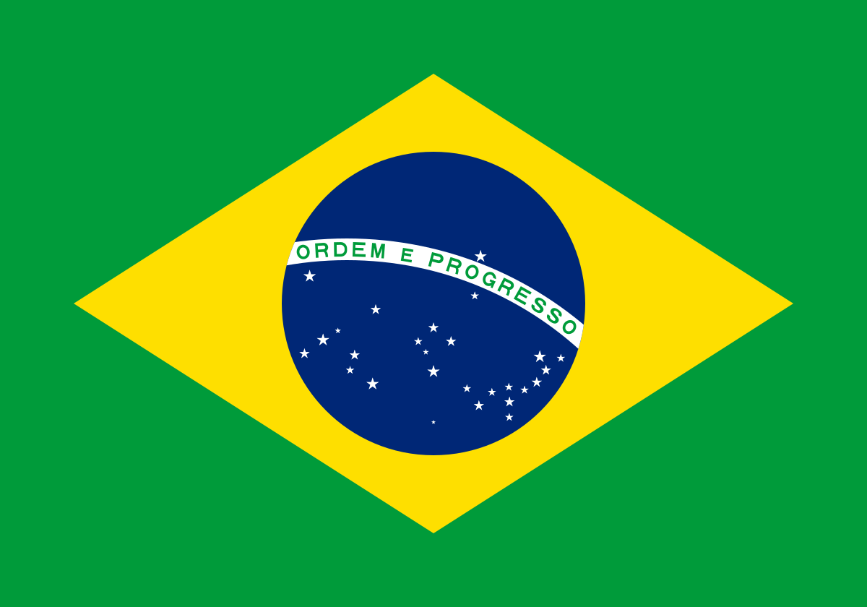
Introducing the dataset
The Brazilian House of Deputies the lower house of the National Congress of Brazil
Reimbursements are given to politicians who spend their own money on things for work
Columns include:
Bugged Date, Receipt Date, Deputy ID, Political Party, State Code, Deputy Name, Receipt SSN, Receipt Description, Establishment, and Receipt Value
Notes:
Holden

Slide 3
Hindrances/Problems in the dataset and how they were resolved
Notes:
Samraj

Slide 4
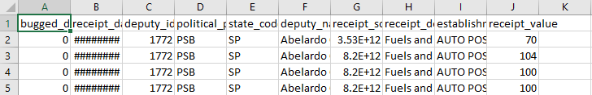
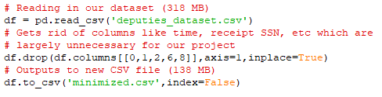
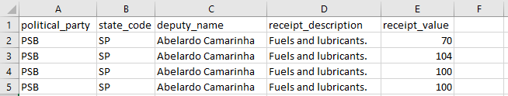
Size
Notes:
We have a huge dataset with approx. 3.01 million items with 10 columns for each.

Slide 5
Specific Items Purchased
No description of items beyond category and vendor
Not directly related to finding outliers, rather verifying their legitimacy

Slide 6
Missing Data
Some missing data in fields like date and establishment
Not necessarily important for us since the most relevant fields were all completed
Scrubbed dataset anyways

Slide 7
Description of our 4 questions and how we created our 4th question

Slide 8
Our 4 Questions
What was the money spent on?
What can be said about some of the outliers in the dataset?
Is there an area (State) that reflects any sort of suspicious activity?
Is there a correlation between Political Party and Spending Per Person?

Slide 9
How did we create our 4th question?
We were interested in seeing the correlation between political parties and spending
One person could have driven spending up so we used the average spending per person to see if this was a common trend in particular parties

Slide 10
What was the money spent on?

Slide 11
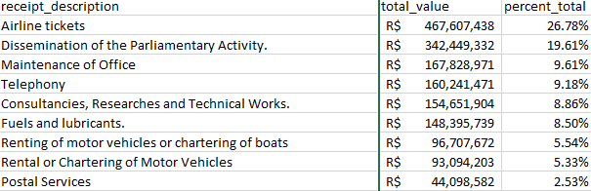
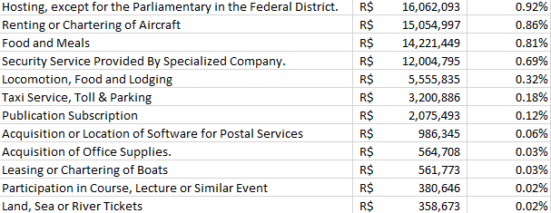
What was the money spent on? pt.1
Though the money was spent in 21 different areas, the top 9 areas of spending account for over 95% of the total money spent.
[Top 9 areas of spending]
[Other areas of spending]
Notes:
Holden

Slide 12
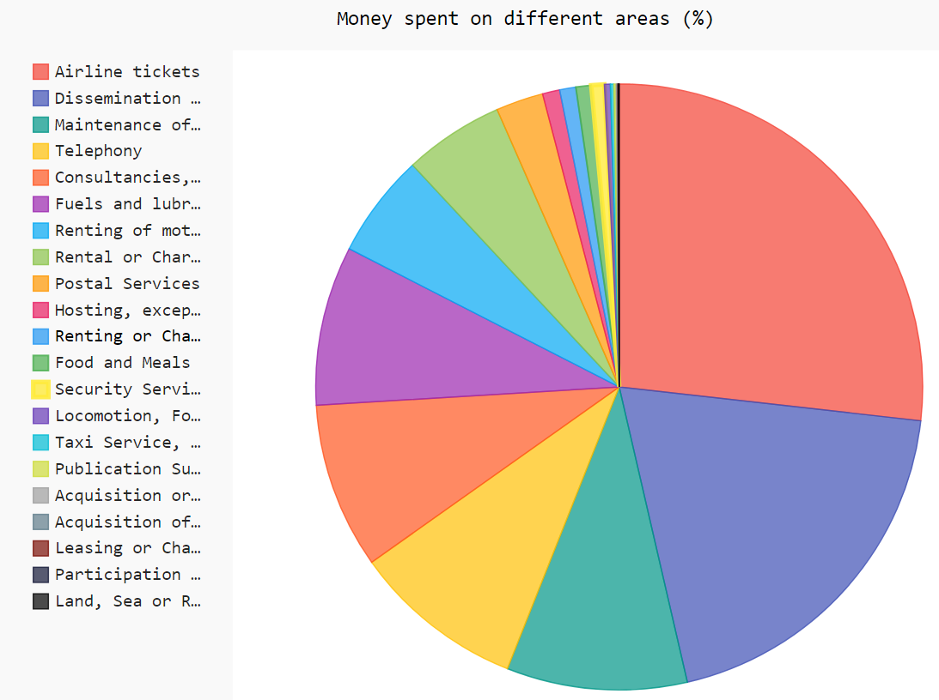
What was the money spent on? pt.2
[Percent of Money Spent]
Airline tickets - 26.78%
Dissemination of the Parliamentary Activity - 19.61%
Maintenance of Office - 9.61%
Telephony - 9.18%
Consultancies, Researches and Technical Works - 8.86%
Fuels and lubricants - 8.50%
Renting of MV or chartering of boats - 5.54%
Rental or Chartering of Motor Vehicles - 5.33%
Postal Services - 2.53%
Other- 4.07%

Slide 13
What can be said about some of the outliers in the dataset?

Slide 14
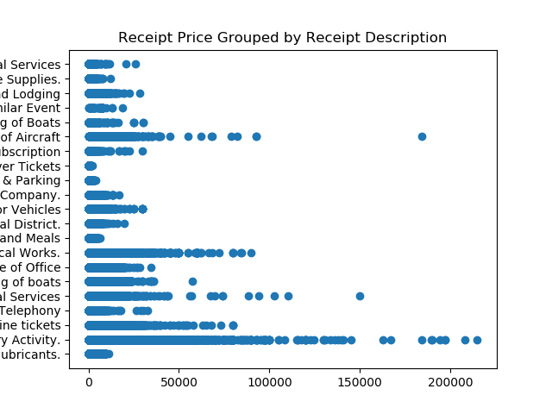
What can be said about some of the outliers in the dataset?
7.74% of data consists of outliers
Outliers were determined using the 1.5*IQR Rule
It’s hard to determine what the purchases were for without elaboration on specific items
Notes:
Samraj

Slide 15
Box Plots Displaying Outliers
Notes:
Samraj

Slide 16
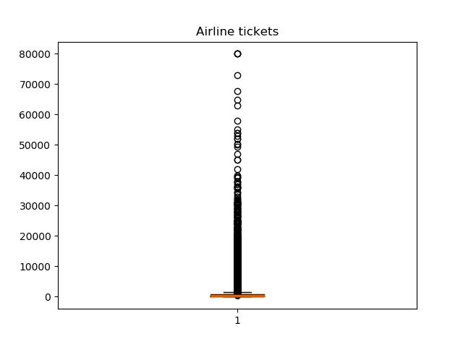
Suspicious Activity
Mean: 586.93
Median: 453
STD: 798.9
Max Value: 80,000
100.137 STD away
Sabino Castelo Branco
Notes:
Samraj

Slide 17
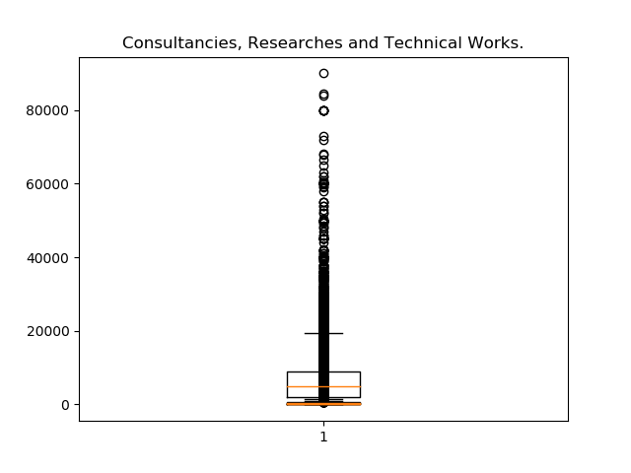
Suspicious Activity
Mean: 6,427.23
Median: 5,000
STD: 6,207.41
Max Value: 90,000
14.498 STD away
Sandro Mabel
Notes:
Samraj

Slide 18
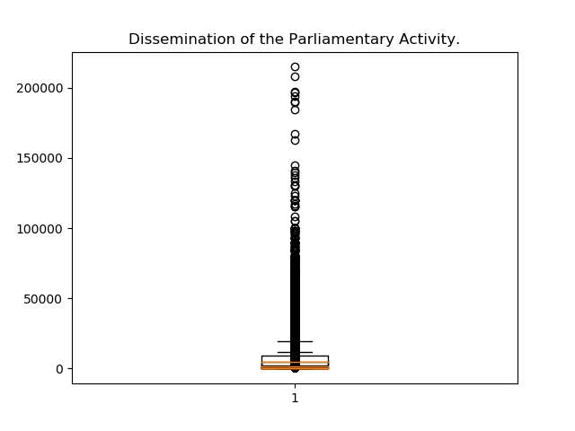
Suspicious Activity
Mean: 4,682.62
Median: 1,800
STD: 8,337.88
Max Value: 215,000
25.785 STD away
Arnaldo Faria De Sá
Notes:
Samraj

Slide 19
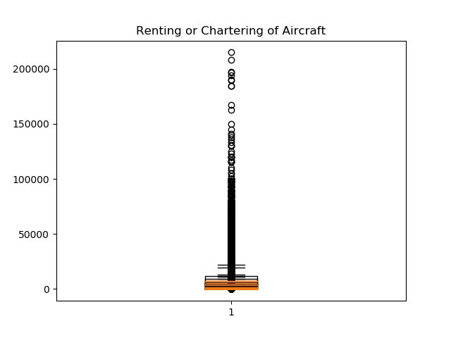
Suspicious Activity
Mean: 9,644.46
Median: 7,500
STD: 9,022.21
Max Value: 184,500
20.449 STD away
Sabino Castelo Branco
Notes:
Samraj

Slide 20

Suspicious Activity
Mean: 132.64
Median: 36
STD: 878.9
Max Value: 149,754
170.388 STD away
Ricardo Tripoli
Notes:
Samraj

Slide 21
Is there an area (State) that reflects any sort of suspicious activity?

Slide 22
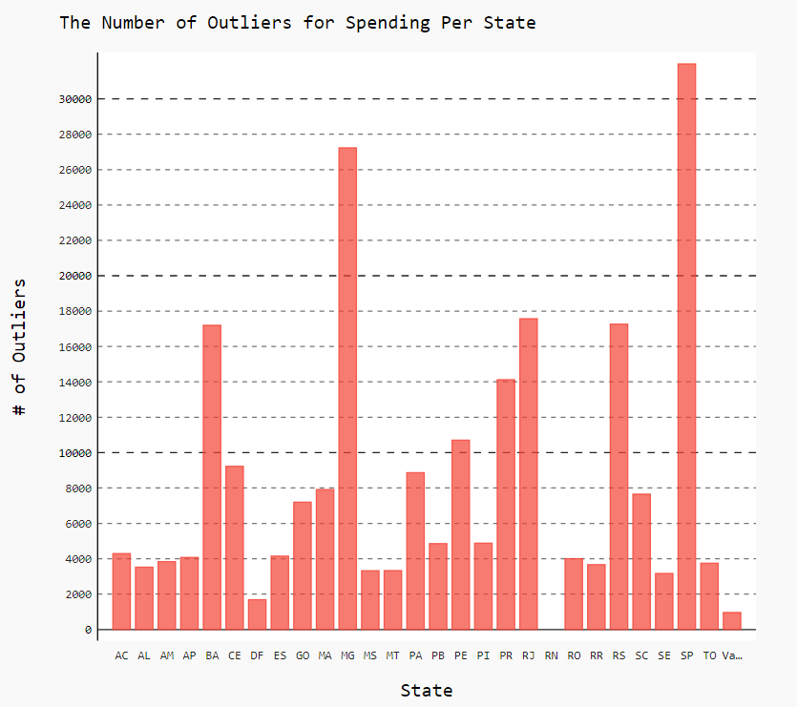
Is there an area (State) that reflects any sort of suspicious activity?
The states MG and SP seem to have an abnormal amount of outliers, with counts of 27231 and 31977, respectively.
Arnaldo Faria De SÃ¡ has the largest transaction, who resides in SP, of 215000 Brazilian real.
The states of DF, RN, and Vazio have a very small amount of outliers, with the state of RN only having 4 outliers.
Notes:
Revanth

Slide 23
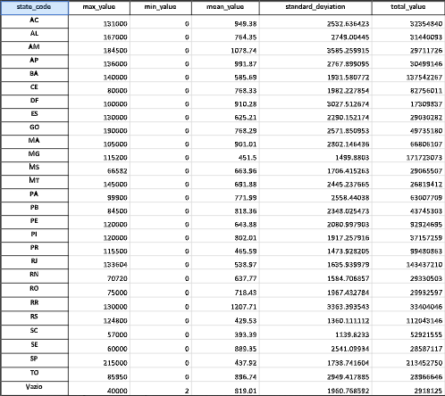

Slide 24
Is there a correlation between Political Party and Spending Per Person?

Slide 25
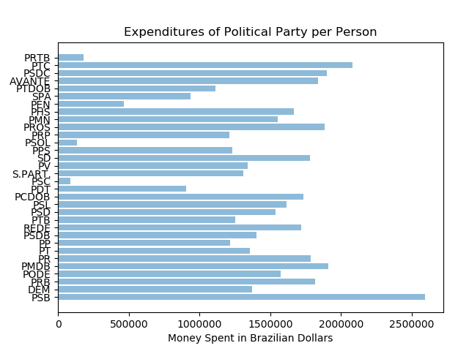
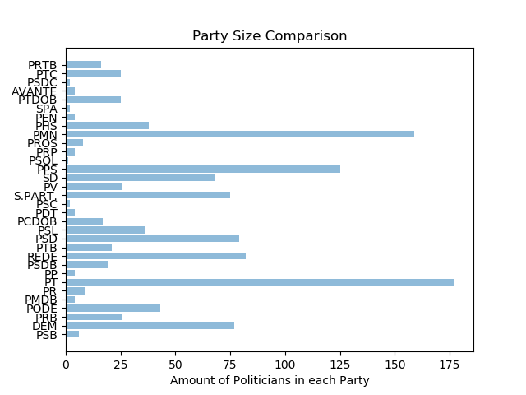
Is there a correlation between Political Party and Spending Per Person?

Slide 26
Is there a correlation between Political Party and Spending Per Person?
While spending per person between Political Party and Spending Per Person seems to be fairly uniform across some parties, we still have outliers that spend an extreme amount per person in them.
A strange trend that can be seen is the negative correlation between party size and spending.

Slide 27
Conclusion
Things We Would Have Liked to Have
Specific items purchased
Conclusion
Overall, there were many outliers for many states.
Some people had suspicious spending patterns, with expenditures of more than 50 std. Dev. away from mean.
A lot of the data leads us to believe that there is corruption within the House of Deputies

Slide 28
Thanks for watching!

